Slide 1
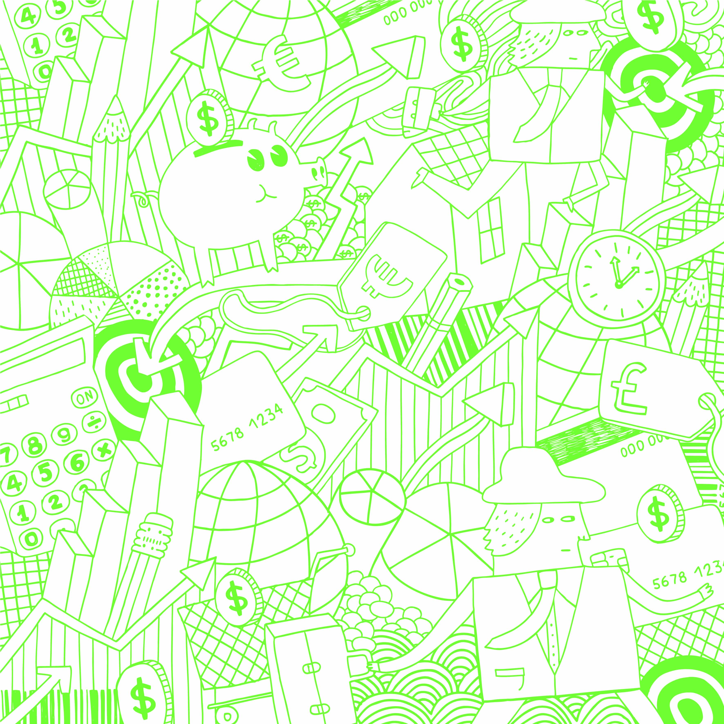
MIDDLE SCHOOL MONEY SENSE
The Greater Washington
Society of CPAs
www.gwscpa.org
Notes:
Introduce yourself to the classroom.

Slide 2

TAKE THE MIDDLE SCHOOL
MONEY SENSE CHALLENGE
Students should be split into two to four teams. Each team will have a spokesperson.
Teams will be asked to answer questions.
For the last question, each team will be asked to wager points.
Need to have a scorekeeper not participating on a team (can be teacher or student).
Notes:
Today I am (we are) asking you to take a challenge! You should already be split into three or four teams. If they are not, have them do it as quickly as possible. Each team should select a spokesperson who will deliver the team’s official answers. With each question, your team will have the ability to earn points. For the last question, your team will be able to wager some or all of its points.
We will also need a scorekeeper. This person will need to be impartial and not on a team. It can be a student, the classroom teacher or an aid.

Slide 3


Throughout the presentation each student will also build a budget.
The budget is geared toward a typical high school student (to help plan for the future).
Students will be able to download an interactive version of the budget to customize for now and in the future.
Notes:
[Hand out budget sheets to the students. These are for them to use, and they do not have to share their answers.]
[Hand out the wager sheets to the spokesperson on each team.]

Slide 4
WHAT IS A BUDGET?
“A budget is telling your money where to go instead of wondering where it went.”
– John Maxwell
A budget is a savings and spending plan.
Budgeting is a tool that can help you achieve financial freedom!
Notes:
A budget is a way to summarize your income and expenses over a certain period of time.
It shows how much money is coming in, where it’s coming from, how much is going out and where it is going. If you know those things you can make decisions on how to spend and save.
Budgets come in many forms and fashions:
You can have a notebook in which you jot down what you spend money on every day
You can use a spreadsheet that helps you summarize your income and expenses
There are websites that help you keep track of your budget
There are many apps that keep a budget
Having a budget will help you cut out expenditures that are unnecessary and adapt depending on your financial goals. When you start breaking down what you spend your money on, you may be surprised where it goes.

Slide 5
WHAT IS A BUDGET?
What are the four main components of budget?
  Income
  Necessary Expenses (Needs)
  Discretionary Spending (Wants)
  Savings
What are sources of income for a typical high school student?
Notes:
[Review the four main components – income, necessary expenses, discretionary spending, savings]
Ask the students what they think are sources of income for someone their age. You can mention if they don’t:
Parents/Family - allowance
Part-time work
Gifts
Selling gently used items (clothing, video games, etc)
Examples of other budget components are reviewed during presentation.

Slide 6

FIRST QUESTION
What is the minimum wage in DC?
Notes:
Remind the teams that they have to come up with one answer per group.
The team with the closest answer gets 10 points. Teams may pick the same answers. Each winning answer gets 10 points.
Once the answers have been given and the points awarded, you will lead the students through a budget exercise of coming up with monthly income.
ANSWER: The minimum wage in Washington DC pays $16.10/hr. (MD is$15 and VA is $12, but there is a bill that would bring it up to $15 in 2026)
____________________________________
Budget Exercise
Come up with a monthly income –
How much cash would you have in your pocket if you worked 15 hours a week for a month? ($16.10 x 15 hrs x 4.3wks) (It is typical for entry level jobs for highschoolers to pay the minimum wage.)
It is approximately $1040 a month before taxes. But you don’t get to keep all of that. A portion is taken out for various taxes (22%).
How much would you have after taxes? You will “net” around $811.
The easy way to calculate is to take the gross amount earned and multiply by .78.
You can also discuss other ways that students may earn/receive money – money from parents for chores or an allowance, side jobs (dog walking, yard work, babysitting), etc.
Have each student record total earnings.

Slide 7

EXPENSES
What are some typical expenses that a high school student would have?
Notes:
(Get suggestions from the students – discuss whether they are needs or wants)
Shoes, clothing, gadgets, phones, electronics
Monthly costs for phones, car insurance, gas
Live streaming for music, videos, movies, etc.
Food – lunches, snacks, coffee, eating out with friends
Household contributions – some students help with the family expenses or help take care of younger siblings

Slide 8

SECOND QUESTION
What does the average large pepperoni pizza cost?
Notes:
Remind the teams that they have to come up with one answer per group.
The team with the closest answer gets 10 points. Teams may pick the same answers. Each winning answer gets 10 points.
Once the answers have been given and the points awarded, you will lead the students through a budget exercise of coming up with monthly expenses.
ANSWER: The average large pepperoni pizza in DC costs $10. (Pizza Slice Index 2021)
The scorekeeper will record the score of the winning team.
______________________________
Group Exercise
Come up with monthly expenses that seem reasonable to your students. Examples of expenses:
Cost of cell phone plan - $40-$90
Streaming videos/music - $10-$20
Food - $50 - $250
Entertainment (concert tickets, movies, carnivals/theme parks)
Clothing – (come up with number with students)
Household Contribution (sharing with family, take care of a sibling)
Have each student write in their budgets what is reasonable for them. These may exceed earnings.

Slide 9

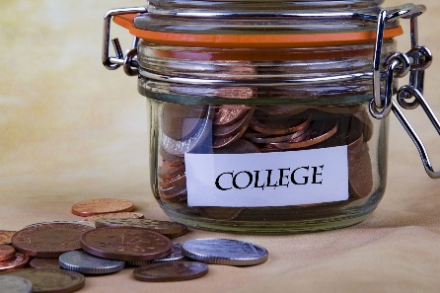


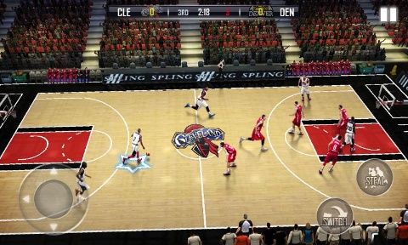
SAVINGS
For what types of items and occasions do you save money?
Notes:
Faith – include a collegish picture here
Ask students why they should be saving money. Examples to share if they do not mention include:
College
Bigger ticket items (cell phones, tablets, sneakers)
Gifts for holidays, Mother’s Day, Father’s Day, birthdays, etc.
Entertainment - concert tickets, movies, water parks, amusement parks, carnivals
Emergencies – Replace/repair broken phone or tablet, taxi or Uber home,
Sports – registration fees, equipment, travel costs
Medical costs, prescriptions, Surgery
Easiest way to save:
Open a checking or savings account at your local bank but remember:
Don’t spend more than you have (you can’t write checks just because you have them!!)
Keep track of your spending.
Keep a cushion in your account for emergencies and to avoid fees, which can be costly!

Slide 10

THIRD QUESTION
What percentage of your income should be saved each month?
Notes:
Remind the teams that they have to come up with one answer per group.
The team with the closest answer gets 10 points. Teams may pick the same answers. Each winning answer gets 10 points.
The correct answer is 10% or higher. This is according to a panel of CPAs. They recommend that 10% is the minimum. More is always better!
Students should record an amount for savings in their budget that is at least 10% of their earnings. Let them know that they may need to tweak their budget later, but that they have a good base to start.

Slide 11

HOW DO YOU SAVE?
Savings Account
Investing
“Compound interest is the eighth wonder of the world. He who understands it, earns it ... he who doesn't ... pays it.” - Unknown
Notes:
What is Compound Interest? Compound interest is interest added to the principal of a deposit or loan so that the added interest also earns interest from then on. When it comes to savings, compound interest is when you earn interest on both the money you’ve saved and the interest you earn.
Assume that starting at 18 you invested $1,000 /year for 10 years at 6% interest compounded daily.
In 10 years your savings is worth $14,117.
If you do not deposit anything else into this account, at age 70 your investment would be worth $175,418
If you wait until you are 35 years old to start, and you invest $1,000 /year for 35 years at 6% interest compounded daily, At age 70 the investment would be worth $123,040
The 18 year old only made a $10K investment, but the 35 yr old made a $35K investment, yet when they reach the age of 70 the 18 yr old is worth $52K+ more than the 35 year old, thus stressing the importance of saving early and starting young while time is on your side.

Slide 12
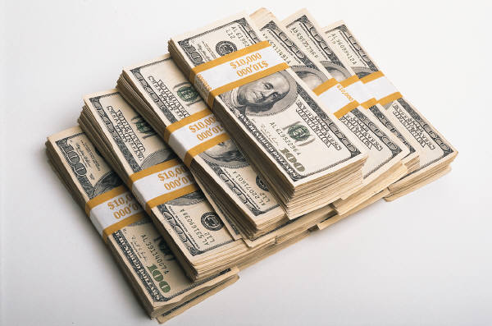
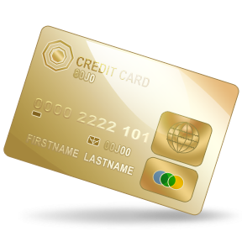

HOW DO YOU PAY?
PAY NOW
  Cash
  Checks/Online Bill Pay
  Debit Cards
PAY LATER
  Credit Card
  Loan
Notes:
Definitions:
Cash - Cash is king. You can only spend what you have.
Checks/online billpay - Similar to paying cash as the money will be taken from your account once it has been presented to the bank.
Debit card - Same as paying cash as the funds will immediately be taken from your checking account. According to Clark Howard, debit cards are at high risk for identity theft.
Credit Card - Remember a credit card is a loan– you must pay this back over a period of time and if over more than a month, then you must pay interest also.
Student loan - You borrow money while in college and then you have to pay it back, plus interest, after you finish college.
(Students may mention payment methods such as Bitcoin, Apple Pay, Venmo – these are all online forms of payment. There are also services that allow for transferring money between people.)
Don’t get caught in the minimum balance trap – This is where compound interest works against you.
Example:
If you buy an iPhone for $699, charge it on a credit card and only pay the minimum credit card payment of $28/month, it will take almost three years to pay for the iPhone and the interest (at 22%) you will pay an additional $315!! You would actually pay over $1,000 for the iPhone that is now three years old and outdated!

Slide 13
BALANCING THE BUDGET
What happens when your expenses exceed your income?
What happens when your income exceeds your expenses?
Notes:
Expenses exceeding income:
Could use a credit card – NOT RECOMMENDED
Could use money from savings – SAVE THIS FOR EMERGENCIES AND VERY IMPORTANT PURCHASES
Reducing expenses is the best option:
Eat out less – make lunches and snacks at home
Hold off on purchases of clothing, games, movie tickets, etc.
Use coupons, look for deals and sales
Income Exceeding Expenses:
Spend it – NOT RECOMMENDED!
Put additional money in savings or investments.

Slide 14
HOW MUCH HAVE YOU LEARNED?
Do you think you are more financially savvy than when the class began?
It is time for your team to place a wager for question 4. You can bet some or all of your points earned.
Write your wager on your team’s wager sheet, fold it over, and give it to the score keeper.
Notes:
This is where the students are able to bet on how much they have learned.
Each team can wager up to 10 points over what they have earned. (If the team has not earned points, they can still wager 10 points. A team with 30 points can wager up to 40 points.)
Remind the teams that they have to come up with one answer per group.
Once the wager sheets have been given to the scorekeeper, You can move on to the final question.

Slide 15
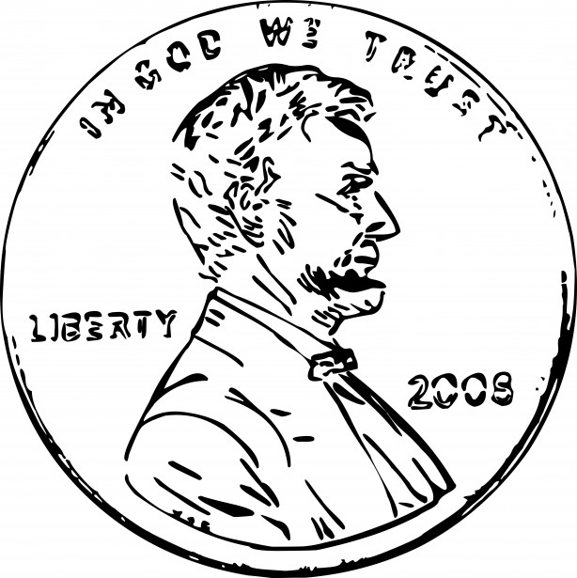
QUESTION 4
Would you rather get:
  A) $1,000,000 today
  B) $.01 today, then double the amount you have each day for 30 days.
Notes:
Remind the teams that they have to come up with one answer per group.
Teams can choose the same answer.
All teams can earn points on this one.
See next slide for answer

Slide 16
THE POWER OF COMPOUNDING INTEREST
Day 1 | $0.01 | Day 11 | $10.24 | Day 21 | $10,485.76
Day 2 | $0.02 | Day 12 | $20.48 | Day 22 | $20,971.52
Day 3 | $0.04 | Day 13 | $40.96 | Day 23 | $41,943.04
Day 4 | $0.08 | Day 14 | $81.92 | Day 24 | $83,886.08
Day 5 | $0.16 | Day 15 | $163.84 | Day 25 | $167,772.16
Day 6 | $0.32 | Day 16 | $327.68 | Day 26 | $335,544.32
Day 7 | $0.64 | Day 17 | $655.36 | Day 27 | $671,088.64
Day 8 | $1.28 | Day 18 | $1,310.72 | Day 28 | $1,342,177.28
Day 9 | $2.56 | Day 19 | $2,621.44 | Day 29 | $2,684,354.56
Day 10 | $5.12 | Day 20 | $5,242.88 | Day 30 | $5,368,709.12
Notes:
The correct answer is B.
There can be a tie between teams.

Slide 17

Financial Literacy Questions?
Financial literacy refers to the set of skills and knowledge that allows individuals to make informed and effective decisions through their understanding of finances.
This presentation is given in an effort to help increase financial literacy and set individuals up for a lifetime of financial stability.

Slide 18
Why do we care about Financial Literacy?
CPA = Certified Public Accountant
What interests you for a career?
Accounting is a career where you can merge your passion or interest with the business acumen to be successful in any setting.
Notes:
First, speak briefly to what a CPA is and how you become one. College + a challenging exam + work experience. (keep it simple) CPAs are trusted because of this rigorous pathway and the strong foundation of Ethics in this profession.
Next, this is a good place to ask what interests them. Try to tie that into a way in which a CPA might be successful in that area. If is a specific brand they are into, maybe a CFO path in industry…. If they care a lot about social issues, maybe they would work in a nonprofit setting…. If they are entrepreneurial, they may end up starting their own business or being a consultant to other entrepreneurs, etc.
Talk about your own career path and something interesting you’ve been able to do as a CPA.

Slide 19

Thank you!
If you want to learn more:
Financial Literacy
https://www.360financialliteracy.org
Explore a CPA Career
https://www.startheregoplaces.com/students/

