Slide 1


Note for presenters:
This presentation is designed as an aid to help you share your career journey with students.
Please remember to keep the presentation conversational and get to know your audience!
Personalize your presentation by:
Updating slides 5-6 & 20 with your personal information and fun pictures prior to the presentation.
Connecting with your state CPA society to update slide 40.
Making your time with the students fun by sharing your journey in a way they can understand. Remember these students have little experience in accounting.
Reviewing the Notes section of the slides for presenter tips and opportunities to engage the students.
Optional activity and survey
The Trivia Game on Slides 30-35 is optional if time permits.
The survey on slide 41 is optional if students are permitted to use their cell phones.

Slide 2


Let’s Talk Business

Slide 3




At the heart of every business is…
People
Products
Service
Marketing
Notes:
What do you think the heart of a business is? – Ask for a few responses from students.
Would you agree with what’s on the slide? Anything I’m missing here?

Slide 4

Money!
Do you get an allowance?
What do you do when you want to buy something?
What do you do when you are given money as a gift?
Notes:
Some of you might save your money, some might want to buy something new. Everyone uses money differently. Many adults also need help with money. Accountants help manage their money and make sure their business can be successful.

Slide 5
Name
Title
Company
I first became interested in accounting when…
My career started…
And now I…Which means I...
My favorite part of my job is…
The coolest thing I’ve done as a CPA is…
You might be surprised to learn I…
Notes:
It’s time to introduce yourself and share your story! The bullet points are available as prompts to share why you chose accounting and your journey thus far.
**Update this slide with picture(s) of yourself, name, title, company and bulleted information you would like to share.
Presenter Tip: Use this slide to include fun photos of your life (versus a headshot). This gives students a better glimpse into your life, and it will make your introduction more engaging and fun.

Slide 6
When I was in school…
I took classes that prepared me for future success. Classes like…
I participated in sports and clubs like…
These prepared me by…
When I was looking for colleges, I wanted…
I knew I wanted to major in accounting because…
In college I set myself apart by…
Notes:
Now put yourself in your audience’s shoes. Think about your high school self. What did you want to be then and, if you changed course to accounting, why? What did you do in high school that may have prepared you for where you are today? What can the students expect when they get to college?
**Update this slide with picture(s) of yourself, and tips on what students can do now to start preparing for their future.
Presenter Tip: Use this slide to include fun photos of your life (versus a headshot). This gives students a better glimpse into your life, and it will make your introduction more engaging and fun.

Slide 7
















Getting to know you
Choose any 5 skills that you are good at
Notes:
(Optional Activity) Now that you know a bit about me, let me find out a bit about you!
Ask students to choose any 5 skills from the grid on the next slide. Give them 2-3minutes to note it down in their notebook.
Call on 2-3 students and get a few responses. Make sure to applaud the student for choosing those skills.
Now connect one of the skills they chose to how that skill can help make them as a good accountant.
Example: Compassion is such a strong skill to have to be a good accountant. We work with different clients all the time and understanding their situation and providing them the right help is crucial. Followed by giving an example from your work.

Slide 8
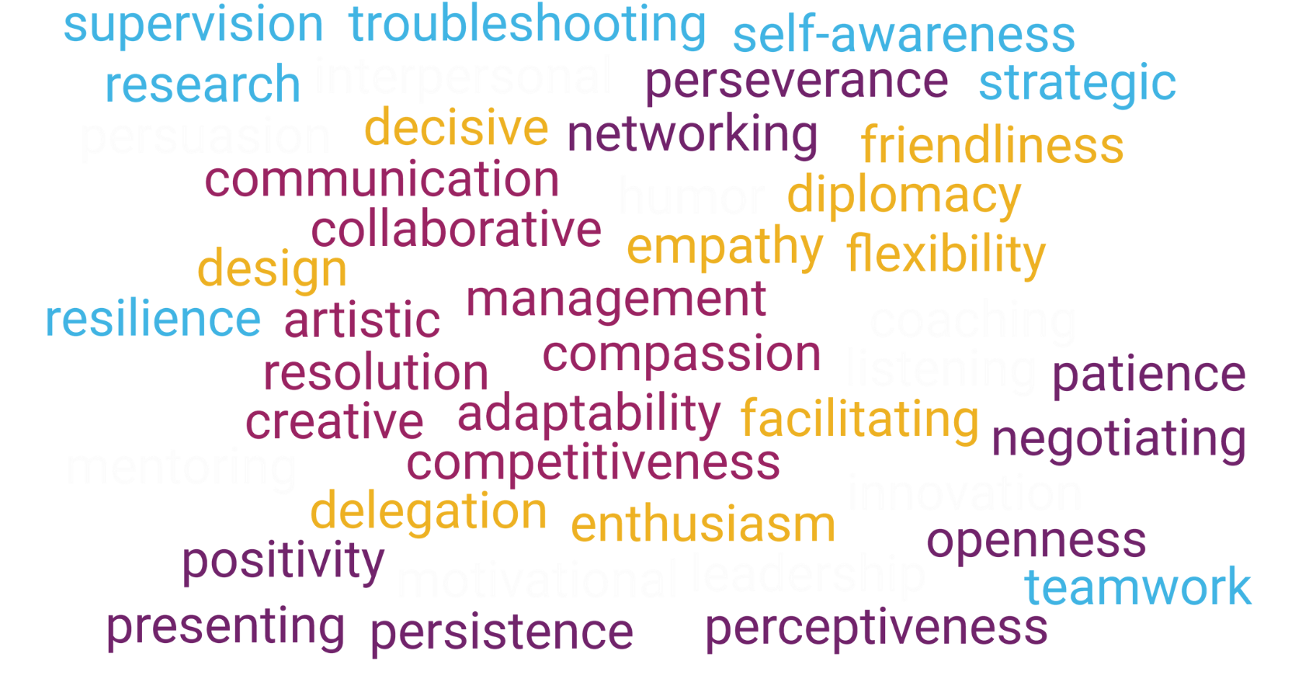
Skills
Notes:
Presenter Tip: Prepare 2-3 concrete examples for a few of these skills in advance. Select skills that reflect the work you do.
Example: Collaborative abilities: As an accountant/CPA I work with multiple clients and manage 2-3 people in my team. Example: I was working on ABC project. It was good to have a team that had different ideas to help the client. We did XYZ.

Slide 9
What are you looking for in a future career?
Notes:
Now that I know the skills you have, let me ask you this. Have you thought about what are you looking for in a future career? <ask the students>
If they answer: What if I told you that you could do all of that with accounting?
If they don’t answer, ask: Who has the coolest job in your family?... Why?
Presenter Tip: A student might answer here that they are interested in becoming an artist, or something unrelated to business or accounting. No matter the career a student may say they want to pursue, point out how a background in accounting can help them. For example, as an artist you want to make sure that you’re bringing in more money than you’re spending on supplies in order to continue pursuing your passion. Learning about accounting and how businesses work will help you succeed in your career.

Slide 10









Money
Owning a Business
Traveling
Making an Impact
Teaching
Work / Life Balance
Professional Growth
Job Security
Notes:
Whether you’re interested in making money, owning a business, traveling, or making an impact in the world, Accounting can give you that and more! Let’s explore a few of these. Where would you like to start?
Presenter Tip: Click on an icon to advance to that slide and learn more. From there, click on the back arrow to take you to back to this slide, where you can choose another option. When you’re ready to advance the presentation, click the forward arrow above.

Slide 11

Accounting is money.
Accounting isn’t math. It’s money.
Accountants are the backbone of the business world and keep finances in check – for everyone.
Notes:
No matter the size of the company, accountants help organizations meet their goals by protecting financial resources.

Slide 12

Follow your passion.
Own a business where your passion lies.
As a CPA, you’ll help ensure its financial success!
Notes:
If you’re interested in owning your own business and being your own boss, consider majoring in accounting. You’ll have the financial know-how to ensure your company is a success!
“Spending a few years working in an accounting role for a firm or industry can be wonderful training for future entrepreneurs. They get to see first-hand how businesses operate and are financed and learn other important lessons that will help them succeed as they launch their own companies.” – Jerry Maginnis, CPA Advice for a Successful Career in the Accounting Profession

Slide 13

Travel the world.
CPAs meet their clients where they are.
That means opportunities for travel for you!
Notes:
In addition to travel, accounting careers provide work flexibility, with many companies offering the ability to work remotely, even worldwide!
Presenter Tip: If you have had the opportunity to travel for work, share your experience here!

Slide 14

Make an impact.
The new field in accounting is ESG: environmental, social and governance. Think carbon emission and climate change.
Accountants can also give back to their community by helping their favorite charity make every dollar count.
Notes:
Accountants ensure companies are complying with federal laws and regulations that hold them accountable to the world around them.
Presenter Tip: If you are involved with a local charity, share your experience here!

Slide 15

Share your knowledge.
Whether tutoring, teaching, or being a consultant for a large company, there are many individuals that can benefit from a conversation with an accountant.
Notes:
CPAs also work in the classroom, to help pave the way for others coming behind them

Slide 16

Make it balance.
We’re not talking about the balance sheet this time.
Accountants work hard, but that hard work affords them the ability to take well deserved time off too!
Notes:
Presenter Tip: Share a positive personal story of the lifestyle/flexibility being a CPA has afforded you. If students mention busy season, say yes, there are times when accountants are busy, but there are also times when they have a lighter workload. The schedule varies depending on the type of accountant you choose to be.

Slide 17

Grow professionally.
Your career growth is in your hands.
As an accountant, you can go into any industry and change your path at any time.
Notes:
Your career growth is in your hands. As a CPA you can go into any industry and change your path at any time. As the world changes and businesses evolve, there are many opportunities for training and growth.

Slide 18

Feel secure.
As an accounting graduate, you will always be in demand and are afforded a clear career path with advancement opportunities.
Notes:
“Accounting is solid. You can always get a job as a CPA.” -Colleen Conrad, NASBA

Slide 19

Accountants work with data and people.
They drive business decisions and strategy.
Typical responsibilities
Implement new accounting technologies and systems
Communicate information to business owners and investors
Analyze financial reports to evaluate business performance
Investigate potential fraud
Confirm financial laws and
regulations are followed
Advise clients on taxes
Help companies thrive in times of uncertainty
Ensure organizations are environmentally and socially responsible
Notes:
Now that we’ve reviewed the benefits of working in accounting, let’s talk about what accountants do.

Slide 20

What does my role in accounting look like?
Typical DAY / responsibilities
My first job out of college was…
This means I…
Now, a day in my life looks like this…
I interact with…
I rely on skills like…
Notes:
Presenter Tip: Share more about your role and some of your typical responsibilities, while relaying it in a way that high school students will understand.

Slide 21

Accountants work in all types of organizations
Entrepreneur/
Start-Ups
Nonprofits
Companies of all Sizes
Governments
Sports & Entertainment
Accounting &
Consulting Firms
1047 Games
Weav
Symbrosia
Habitat for Humanity
Smithsonian
World Central Kitchen
Apple
Ikea
Bank of America
Zappos
Everlight Solar
City Government
FBI
NASA
Military
NFL
TikTok
Disney
Netflix
Local
Regional
National
International
Notes:
While I have worked <insert companies you have worked in>, accountants work in all types of organizations. Several of these names should look familiar to you.
Presenter Tip: Take a moment to highlight companies/industries specific to your state or area and explain how an accountant helps those companies. And add your own firm’s name above!
State Tip: Update the company names to highlight local start-ups, firms, etc.
Organizations listed above:
Start-Ups: 1047 Games, Weav (fintech startup), and Symbrosia (solving climate change) were all featured on Forbes 30 under 30
Nonprofits: Habitat for Humanity, Smithsonian and World Central Kitchen
Companies of all Sizes: Apple, Ikea, Bank of America, Zappos, Everlight Solar
Governments: Along with City Governments, there’s the FBI, NASA, and Military
Sports & Entertainment: NFL, TikTok, Disney (and the new Disney+) and Netflix
Accounting & Consulting Firms: Local, Regional, National and International

Slide 22
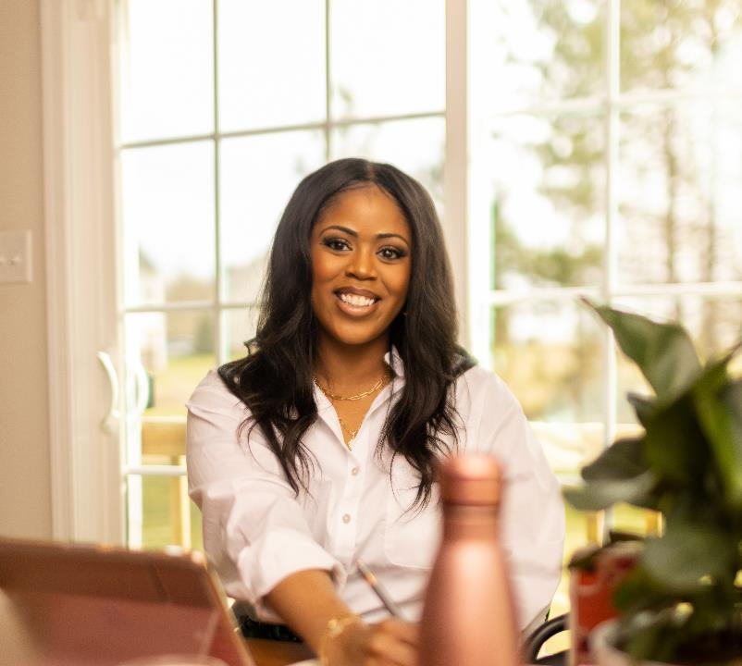


Work with influencers.
"When I was a student, I watched a lot of YouTube videos, and I was always enamored with the idea that these creators made a living simply by living. Studying accounting and becoming a CPA has allowed me to work closely with content creators to help them understand the financial side of their business. I am grateful to have found a career that allows me to merge both my love for accounting with my love for content creation."
@CourtneyArrington_
Notes:
Not only do accountants work in all types of organizations, but they work with all types of people, too. Meet Courtney Arrington. Courtney is a CPA, a member of the Virginia Society of CPAs, and works with content creators.

Slide 23




Be an influencer.
“My journey through public accounting ultimately led me to content creation. I never dreamed there was a career to be made out of making silly things online. Job security is what first led me to accounting, but what will keep me here the rest of my career is the fact accounting is everywhere, and I'm still discovering new & interesting ways to apply the skillset.”
- Jason Staats, CPA, MBA
Jason Daily
@jasoncpa
Notes:
Or BE an influencer. Meet Jason Staats, a member of the Oregon Society of CPAs. Jason is a CPA who has found his way to content creation.

Slide 24

Shape a brighter future.
“As the CFO of Girl Scouts Nation's Capital, I'm thrilled that every day I contribute to the growth of young girls who are the future leaders of our society. I help build girls of courage, confidence, and character, who want to make the world a better place. Being a CPA allows me to use my accounting skills to have a profound impact on the next generation of leaders. I get to make a difference and shape a brighter future!”
- Jessica McClain, CPA, CITP
(Pictured on Right)
Notes:
What about working with your favorite non-profit organization as a CPA? Meet Jessica McClain. Jessica (pictured on Right) is the CFO of Girls Scouts Nation’s Capital right here in the DC area -- where she gets to make a difference by helping build girls of courage, confidence and character who want to make the world a better place.

Slide 25
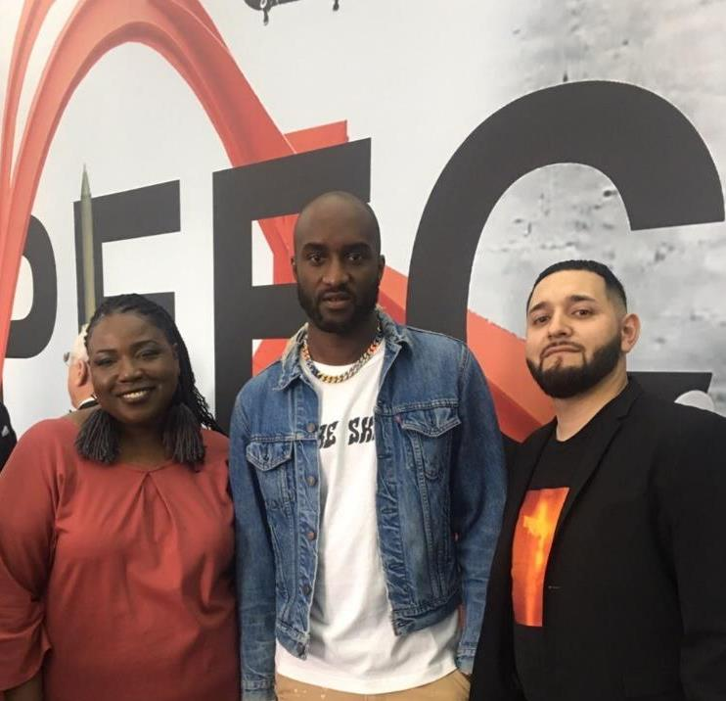
Drive change.
"I help The Joyce Foundation achieve its racial equity-focused mission by ensuring that our team utilizes its funds effectively and responsibly. I also drive change by ensuring we are tax-compliant, by having a strong internal control environment, and by helping team members interpret and digest financial data so that they can make more informed decisions."
- Francisco Velasco, CPA
(Pictured on Right)
Notes:
Meet Francisco Velasco. Francisco’s company funds several art exhibits throughout the Great Lakes Region. In 2019, they funded "Figures of Speech" at the Museum of Contemporary Art. The exhibit featured work from Virgil Abloh (pictured here), creator of the clothing brand Off-white, is also the former men's director for Louis Vuitton, and has had successful collaborations with many brands such as Nike. Also pictured with Francisco is Tracie Hall. Tracie is his good friend who is the current Executive Director at the American Library Association. Tracie was also recently featured on Time's 100 Most Influential People of 2023.
Not only do CPAs get to do some great work, but they also get to hang out with some great people too!

Slide 26


Accountants have many
Chief Financial Officer (CFO)
Tax
Advisor
Forensic Accountant
opportunities
Owner/
CEO
Audit Manager
Financial Planner
Data Analyst
Notes:
We’ve just met some CPAs with pretty cool jobs. These are just some of the other job titles you could have as an accountant.
Presenter Tip: Share some of the various job titles you have held throughout your career, highlighting the progression or path changes you have made.

Slide 27

San Francisco
Senior Manager - $235,238
Manager - $168,413
Associate - $93,825
Chicago
Senior Manager - $216,070
Manager - $154,690
Associate - $86,180
NYC
Senior Manager - $240,465
Manager - $172,155
Associate - $95,910
Source: Robert Half 2024 Salary Guide – Audit/Assurance Services – Public Accounting 75th percentile
Notes:
And accountants make good money. The salaries referenced here are from the Robert Half Salary Guide – Audit/Assurance Services in Public Accounting, and represent the 75th percentile. Stay the course and make Partner, and start around $400K+ per year.

Slide 28

Accountant or CPA – what's the difference?
CPAs are Accountants who:
Are certified – CPA stands for Certified Public Accountant
Earn more throughout their career
Garner more trust and respect
Experience greater job security
Can become even more specialized
Take on highly valued, consulting roles
Notes:
While all CPAs are accountants, not all accountants are CPAs. CPAs are accountants who are certified. CPA stands for Certified Public Accountant. A CPA is a trusted advisor to individuals, businesses, and other organizations, helping each achieve their financial dreams and goals. Whether advising businesses on multi-million-dollar acquisitions, auditing companies’ 401K plans, or helping people invest for retirement, a CPA’s adherence to a strict code of ethics along with accounting and finance expertise allows the public to put their trust in CPAs.
To become a CPA, they had to meet their state’s experience and education requirements, pass 4 sections of the CPA Exam and, in some states, complete an ethics requirement as well.

Slide 29


What do you need to become a CPA?
+
+
+
=
Education
Experience
Ethics*
Exam
CPA
* Certain states require a separate ethics assessment in addition to what is tested on the CPA Exam.
Notes:
What does it take to be a CPA? Exact requirements vary by state, but essentially all CPAs need…
The 4 E’s:
Experience (1-2 years in most states)
Education (150 hours)
Examination (passing 3 core sections and your choice of a discipline)
Ethics (some states do not require this)

Slide 30



ACCOUNTING TRIVIA
How well do you know accounting?
Notes:
(Optional Activity) Get students excited to play a game! Ask students to raise their hand to answer.
Presenter Tip: Consider having students form teams or grab a partner. Ask all questions and reveal the answers at the end. Bring small giveaways or candy for the winners!

Slide 31


This candy was invented by an accountant:
Taffy
Bubblegum
Nerds
Lollipop
Notes:
B. Bubblegum - Walter Diemar invented bubblegum in 1928. It was bright pink in color because that was the only dye he had on hand at the time.

Slide 32
The word accounting is derived from which language?
Spanish
German
Latin
French
Notes:
D. French - The word “accounting” comes from the French “compter” meaning to count or score. Other accounting terms are derived from Latin, such as “debit” – “he owes” and “credit” – “he trusts”.

Slide 33
It was accountants who brought down this Chicago crime boss:
John Gotti
Frank Costello
Al Capone
Bugsy Siegel
Notes:
C. Al Capone - Although believed to be guilty of everything from bootlegging to murder, he was ultimately arrested and convicted of tax evasion.

Slide 34
Which of the following celebrities started out studying accounting?
Mick Jagger
Chuck Liddell
Janet Jackson
All of the above
Notes:
D. All of the above - A number of celebrities started out studying accounting. These include Mick Jagger, lead singer of the Rolling Stones; Chuck Liddell, UFC Hall of Fame Fighter; and singer/songwriter Janet Jackson.

Slide 35
CPA stands for…
Certified Professional Accountant
Certified Public Accountant
Certificate of Professional Accountancy
Center for Public Accountants
Notes:
B. Certified Public Accountant

Slide 36




Could accounting be right for you?
RAISE YOUR HAND IF YOU…
Want flexibility in your career
Like puzzles
Like technology
Like working in teams
Like helping people
Like detective work
Want to learn the language of business
Notes:
So, could accounting be right for you?
Presenter Tip: Make this part interactive and ask the students to raise their hand for each question they relate to.
If this sounds like you, explore accounting!

Slide 37

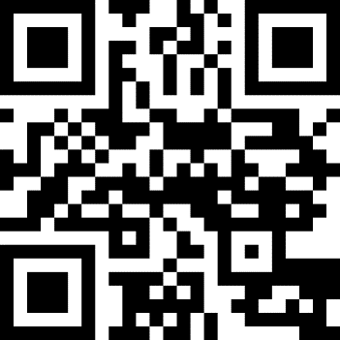

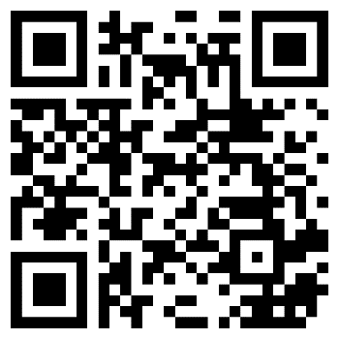
Learn more about accounting
Take an accounting class if available
Write down your presenter’s information for future reference
Discuss accounting with your career counselor
Talk to the adults in your life – who do you know that is a CPA that you can shadow for a day?
Follow the QR code and bookmark ThisWayToCPA.com for more information about accounting and becoming a CPA
Follow the QR code and bookmark JoinAccountingPlus.com for more information about the accounting profession
Notes:
There are things you can do now to learn more about accounting.
Presenter Tip: If you’re willing, offer to help students with networking (explain what this entails – networking is a new concept for high school students) and connecting them with CPAs to learn more.
Additional Information:
ThisWayToCPA.com: The AICPA & CIMA represents nearly 600,000 members and students in public and management accounting. This Way To CPA is the AICPA’s website for students and educators, where you can learn more about career options in accounting, prepare for college, learn what it takes to become a CPA, and hear from real-life accountants.
Accounting+: As you start getting ready to make the choices that set the state for your education and future career, Accounting+ is a resource for you. From information on financing your college degree to insights from those already at work in the industry, and even information on scholarships and internships, Accounting+ provides you with the resources you need to build a plan for your education, your dreams and your dream career.

Slide 38
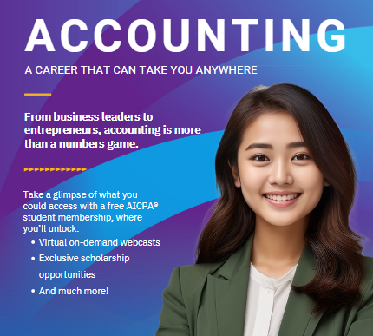

Join over 40,000 other students as an AICPA student affiliate member!
Notes:
High school and college students are eligible for free AICPA student affiliate membership where you can:
Hear from Professionals: Wondering what CPAs really do? Join live and on-demand webinars to learn about accounting career paths and find your fit!
Pay for College: The AICPA Foundation awards over $1 Million in scholarship funds to students majoring in accounting!
Earn Digital Badges: Take advantage of Career Launchpad, an AI-guided resource with advice, stories and behind-the-scenes tips for landing your first job.
Build Your Profile: Using templates and professional advice, build your LinkedIn Profile to ensure you’ll stand out!

Slide 39








Follow us: @AICPAstudent
Contact Us:
www.ThisWayToCPA.com
ThisWayToCPA@aicpa.org
Notes:
If you’re on social media, be sure to follow @AICPAstudent for information on upcoming webinars, scholarship deadlines, and even a little accounting humor.

Slide 40

State Specific Slide
Find out about local resources and opportunities available through your state CPA society
www.gwscpa.org
Notes:
This slide is available for state CPA societies to personalize with programs and resources available for high school students. Include QR codes and websites where available.

Slide 41
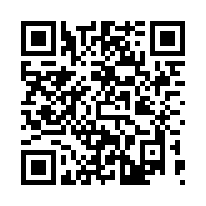
A quick survey as we wrap up
Notes:
Please first ask the teacher if students are permitted to use their cell phones before asking students to complete the survey.
You may skip this slide if not permitted.
We’d like to gauge students’ feelings on accounting following the presentation and ask that they complete a post-survey. The survey is voluntary, only 7 questions long and will take 1-2 minutes to complete. Ask students to point the camera on their phone to the QR code on the screen and follow the link that comes up.
The following questions are asked:
How did this presentation affect your interest in accounting as a career?
Where do you learn about possible careers?
What is the likelihood that you will pursue accounting as a major?
What is your high school graduation date?
What is the name of the school you are currently attending?
In what City and State is your school located?
What are your plans following high school graduation?
*Optional* If you would like to receive email updates from the AICPA on opportunities in accounting, scholarships, and free student membership, please provide your name and email address.

Slide 42

Questions?
Notes:
At this point, students can ask questions.

Slide 43


Thank You
Presenter name
Email address
Website address
Notes:
Update this slide with your contact information as you close out the session. If you’re willing, suggest that students take down your information if they have any future questions.

